Slide 1
Employee Data Analysis using Excel
STUDENT NAME: HEMAVARSHINI R
REGISTER NO: D48DB96A7A3E79C9CEF4A7A571D6F22B
DEPARTMENT: B. COM ( GENERAL)
COLLEGE: MEENAKSHI COLLEGE FOR WOMEN

Slide 2
PROJECT TITLE
Employee Performance Analysis using Excel based on Gender, Department, FTE

Slide 3


AGENDA
Problem Statement
Project Overview
End Users
Our Solution and Proposition
Dataset Description
Modelling Approach
Results and Discussion
Conclusion
3/21/2024 Annual Review

Slide 4

PROBLEM STATEMENT The purpose of project based on department gender FTE aims to analyze gender distribution within different departments of an organization. By assessing the Full-Time Equivalent data, the project seeks to identify any gender imbalances and understand their implications.

Slide 5

PROJECT OVERVIEW To analyze employee performance across departments with consideration of gender and FTE, start by collecting comprehensive data on performance metrics, such as reviews and productivity, alongside gender and FTE information for each department.
.

Slide 6

WHO ARE THE END USERS? HUMAN RESOUCE DEPARTMENTS MANAGEMENT AND LEADERSHIP TEAM LEADERS AND SUPERVISORS EMPLOYESS EXECUTIVE LEADERSHIP BUSINESS ANALYSTS RECRUITERS

Slide 7

OUR SOLUTION AND ITS VALUE PROPOSITION FILTERING - REMOVE VALUES PIVOT TABLE – SUMMARY OF EMPLOYEE PERFORMANCE BAR DIAGRAM – FINAL REPORT

Slide 8
DATASET DESCRIPTION EMPLOYEE DATA SET – KAGGLE PORTAL 9 FEATURES IN EXCEL: EMPLOYEE ID – ALPHANUMERIC(TEXT) NAME – ALPHABETICAL(TEXT) GENDER – ALPHABETICAL(TEXT) DEPARTMENT – ALPHABETICAL(TEXT) SALARY – NUMERICAL START DATE – ALPHANUMERIC(TEXT) FTE – NUMERICAL EMPLOYEE TYPE – ALPHABETICAL(TEXT) EMPLOYEE LOCATION – ALPHABETICAL(TEXT) 3 FEATURES USED: DEPARTMENT – ALPHABETICAL(TEXT) FTE – NUMERICAL GENDER – ALPHABETICAL(TEXT)

Slide 9

THE "WOW" IN OUR SOLUTION Exceptional performance of employees achieve results far beyond expectations, such as ultra - fast speed or unmatched accuracy. Social impact makes a positive difference in communities or addressing important social issues effectively.
3/21/2024 Annual Review
9

Slide 10
MODELLING
STEP – 1
DOWNLOAD THE EMPLOYEE DATASET AND OPEN THE EMPLOYEE DATASET IN EXCEL.
STEP – 2
SELECT THE ENTIRE DATA AND CLICK ON DATA AND CLICK ON FILTER OPTION.
STEP – 3
FILTER FROM A TO Z ORDER.
STEP – 4
SELECT THE ENTIRE DATA AND CLICK ON INSERT AND CLICK ON PIVOT TABLE TO CREATE PIVOT TABLE.
10

Slide 11
STEP – 5 DRAG THE NEEDED DATA AND CREATE A PIVOT TABLE. STEP – 6 SELECT THE PIVOT TABLE AND CLICK ON INSERT STEP – 7 NOW LICK ON THE CHART THAT YOU WANT. STEP – 8 THE CHART IS CREATED.

Slide 12
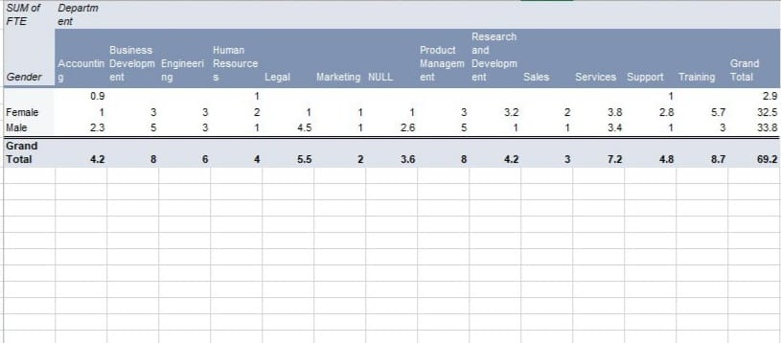
RESULTS 1.TABLE
12

Slide 13
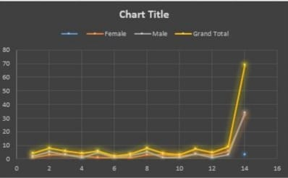
2. BAR DIAGRAM

Slide 14
Conclusion The data set reveals the overall composition of the workforce, including demographics such as gender, type of department. These information plays an important role in an organization. The analysis of gender distribution across departments reveals significant insights into our organizational demographics.

